Slide 1

Corrugated waveguide – Course correction
A. Herrero Parareda and F. Capolino
Department of Electrical Engineering and Computer Science

Slide 2
Course correction
The previous approaches were informative. Now is the time to start engineering the dispersion diagram to get an SIP
To get mode coupling, increase teethWidth to get a mode to reside in the teeth
We must show the polarization of each mode in the dispersion diagram. We can check whether the modes coalesce if the polarization changes from one branch to the other after the crossing
Look at the 4th mode as well
The 3rd mode seems to have the beginning of an SIP
We need:
A denser mesh
A denser Phase_Z_vec
Initial values:
teethThickness = period/2
teethShift = period/2
teethWidth = [0, 50, 100, 150] -> How are the modes perturbed as you vary the width?
Parameters to adjust: teethShift, teethWidth

Slide 3
Corrugated waveguide – Course correction on Case 0: Uniform waveguide supports 2 modes
A. Herrero Parareda and F. Capolino
Department of Electrical Engineering and Computer Science

Slide 4
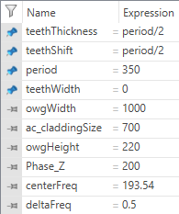
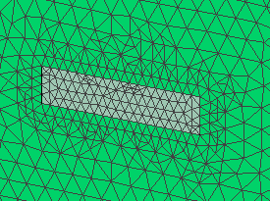
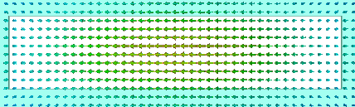
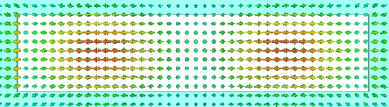
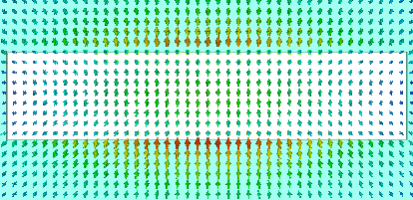
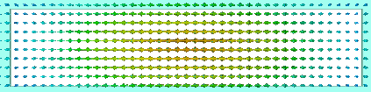
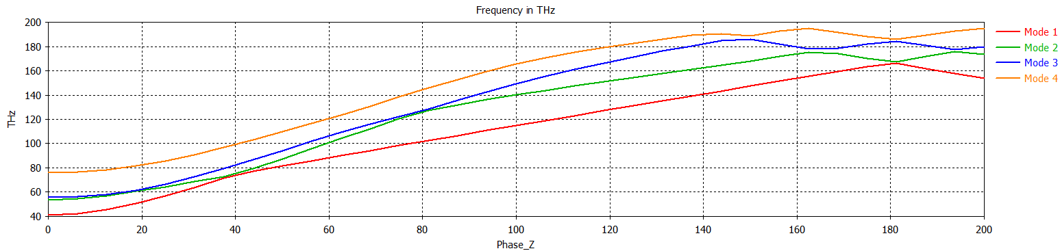
Uniform waveguide (teethWidth = 0)
Mode 1
Mode 2
Mode 3
Mode 4
BZ edge

Slide 5
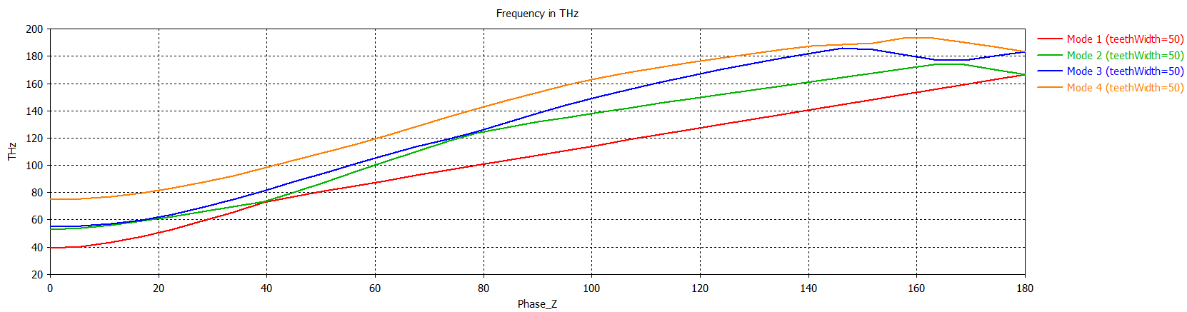
teethWidth = 50

Slide 6

teethWidth = 100

Slide 7
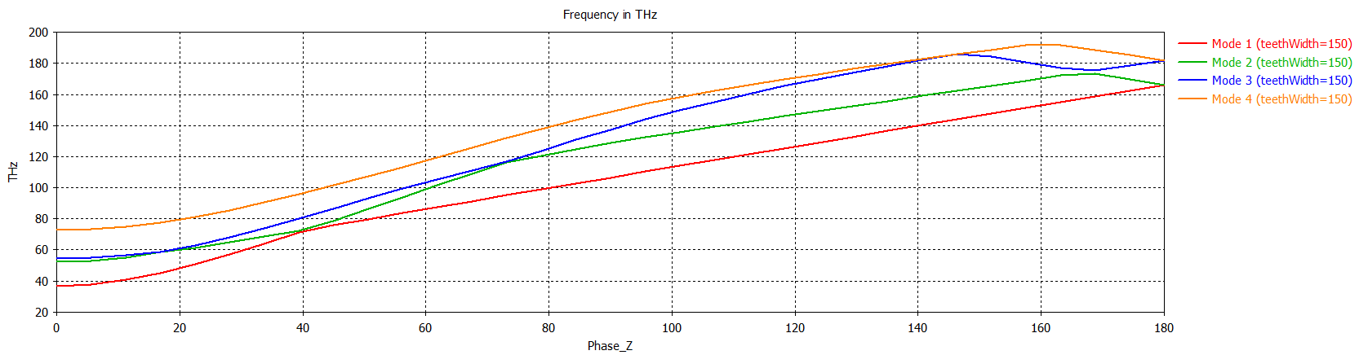
teethWidth = 150

Slide 8
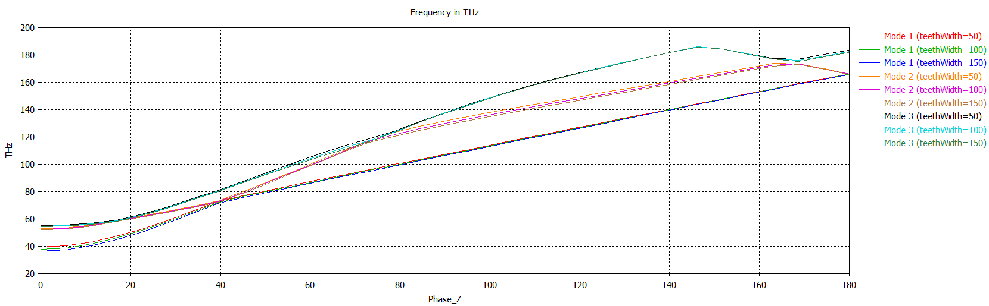
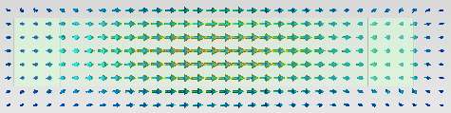
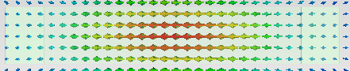
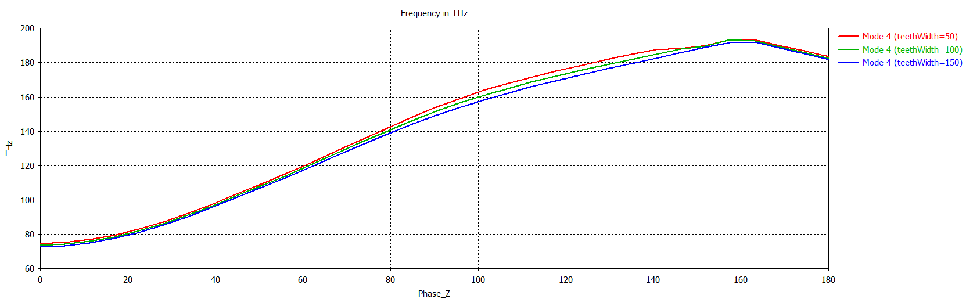
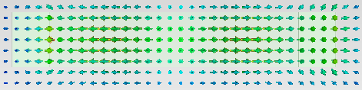
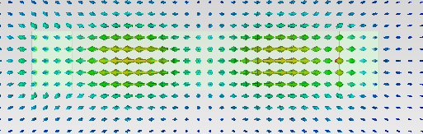
Mode perturbation due to teethWidth
Mode 1, 2 & 3 are mostly unperturbed (same curves)
Mode 4 has the most perturbation
Mode 4 is an odd mode (like Mode 3)

Slide 9
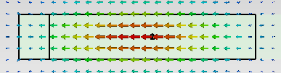
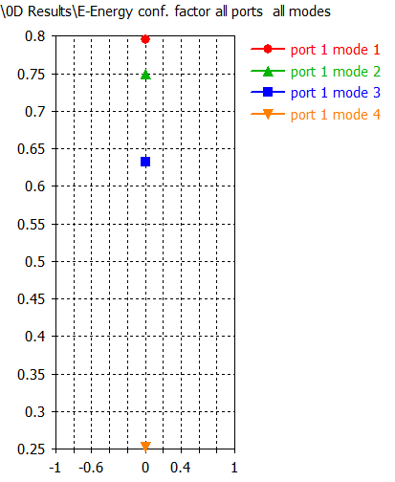
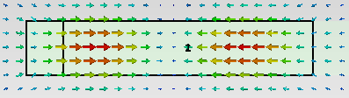
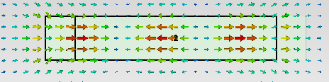
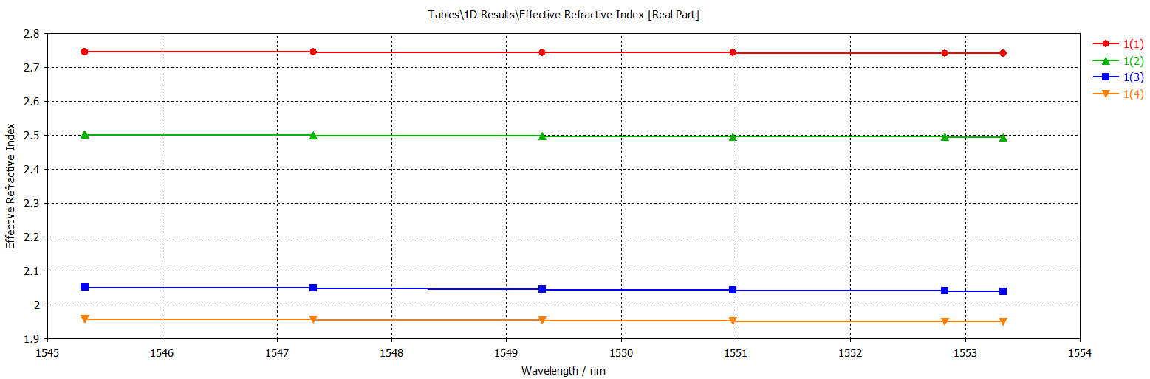
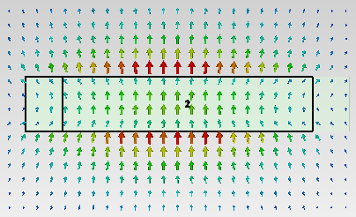
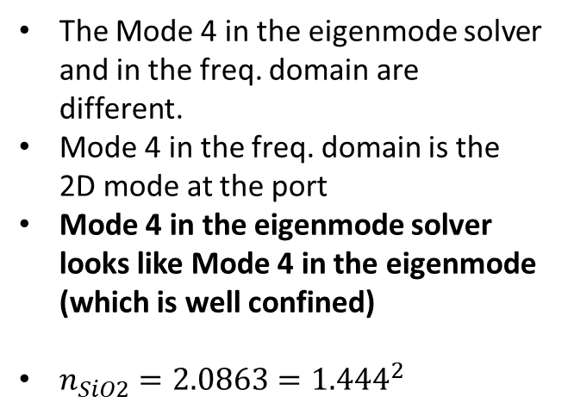
Check: Mode confinement in freq. domain
The Mode 4 in the eigenmode solver and in the freq. domain are different.
Mode 4 in the freq. domain is the 2D mode at the port
Mode 4 in the eigenmode solver looks like Mode 4 in the eigenmode (which is well confined)
$n_{SiO2}=2.0863={1.444}^{2}$

Slide 10
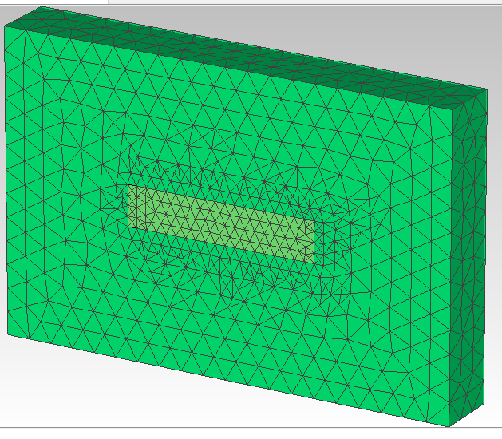
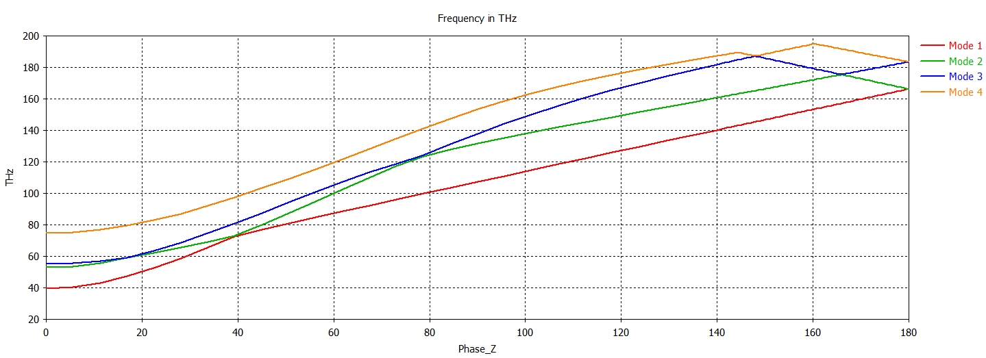
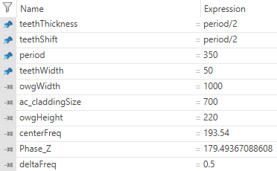
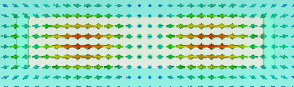
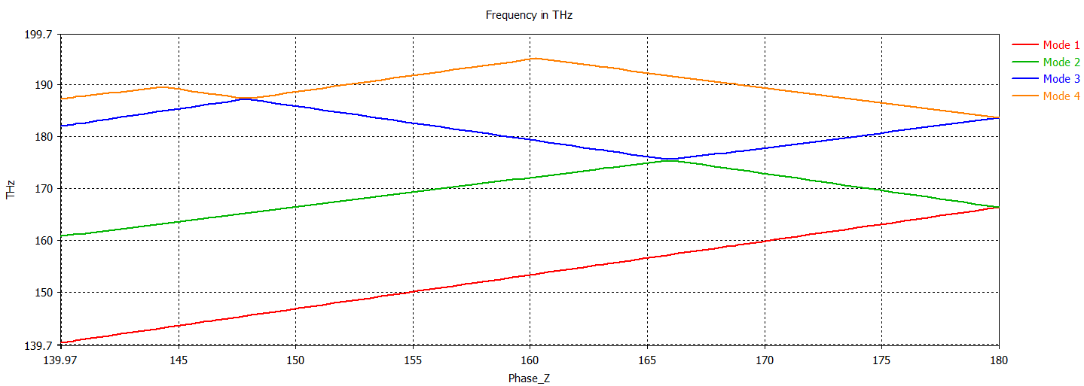
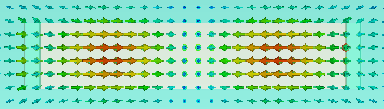
teethWidth = 50
Mode 3
Mode 4

Slide 11
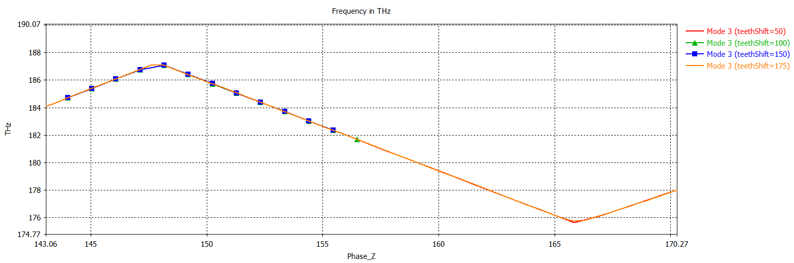
Optimizing teethShift
Changing the value of teethShift does not significantly perturb the dispersion diagram

Slide 12
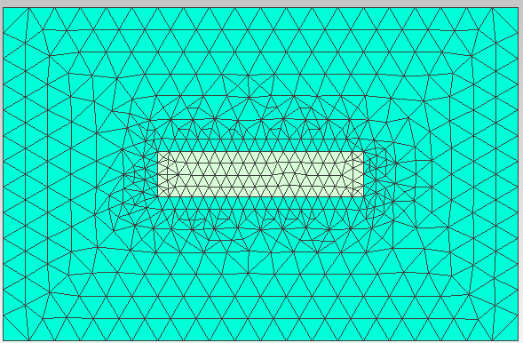
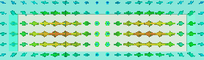
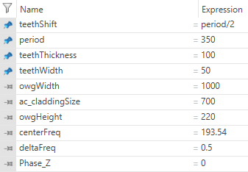
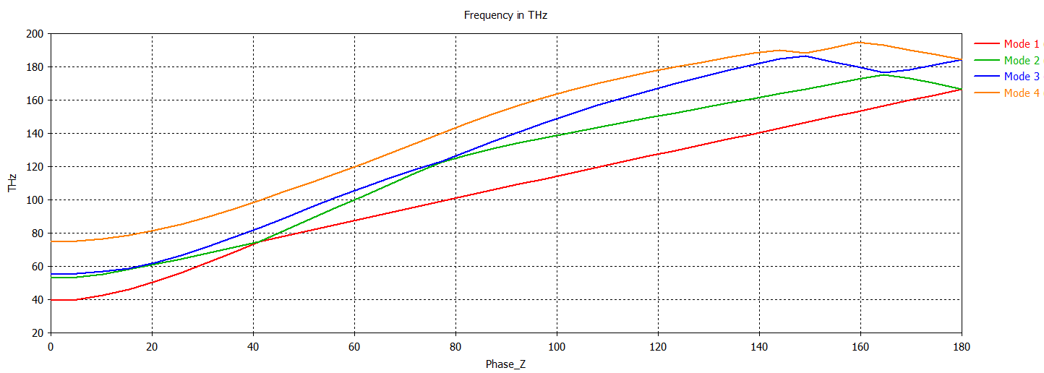
What if we change teethThickness?
Mode 3

Slide 13
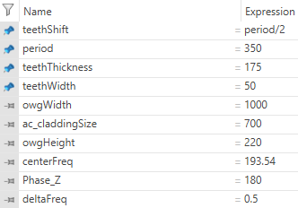
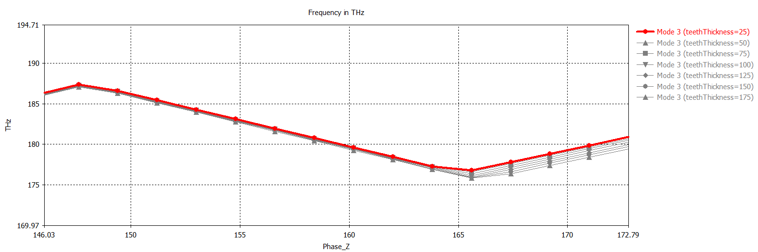
Let’s focus on Mode 3

Slide 14
Conclusions so far
Changing the teethWidth alone does not change the dispersion diagram too much
Changing the teethShift alone does not change the dispersion diagram too much
The teethThickness does change it more. The smaller the thickness, the less difference between the peak and the valley of mode 3
I need to vary more than 1 at the same time. Let’s try to find the best teethThickness, set it, and then change teethWidth. Then teethShift
I am now checking to see if increasing the density of the mesh changes the results significantly or not

Slide 15
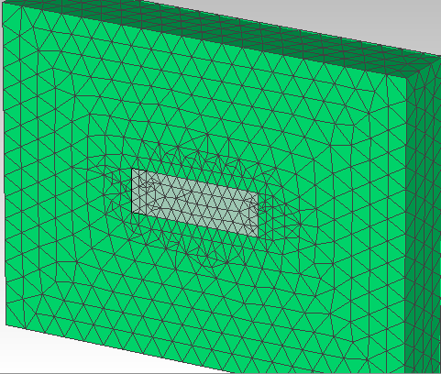
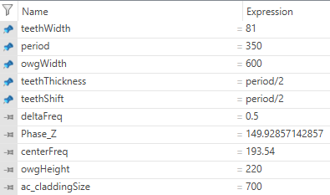
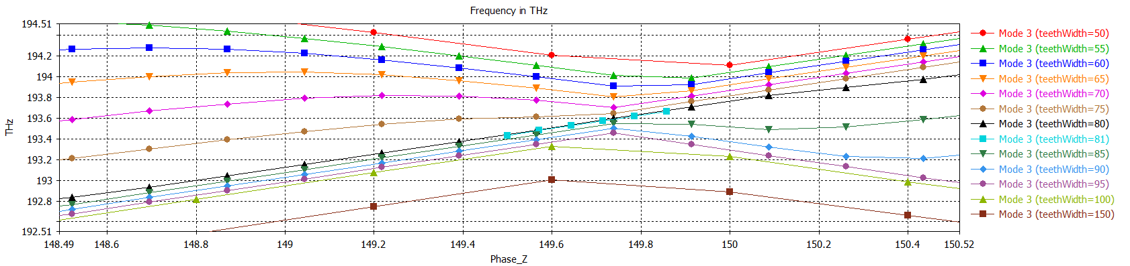
Sweep teethWidth to fine tune
I am running a finer tuning

Slide 16
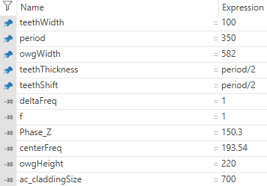

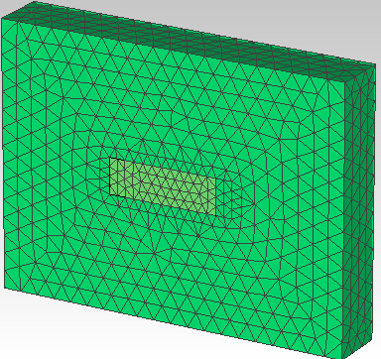
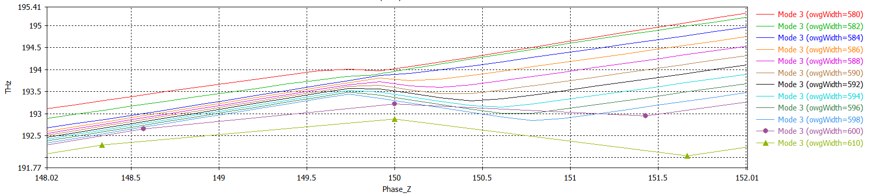
Sweep period to fine tune
I am running a finer tuning

Slide 18
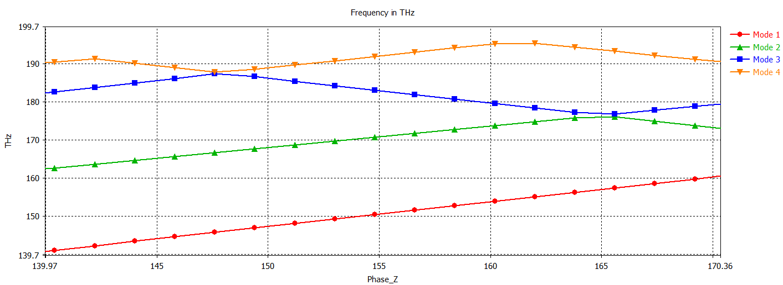
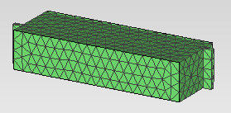
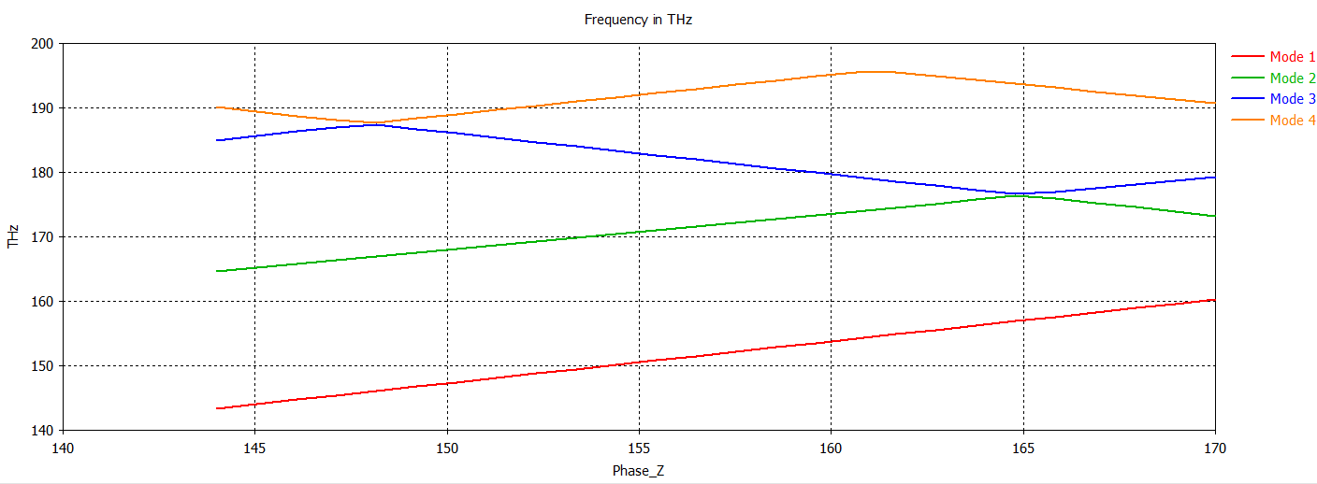
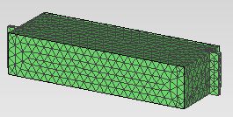
Mesh density comparison
Low density: 8 cells per wavelength
High density: 10 cells per wavelength
There is no noticeable difference

Slide 19
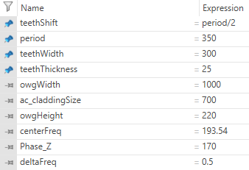
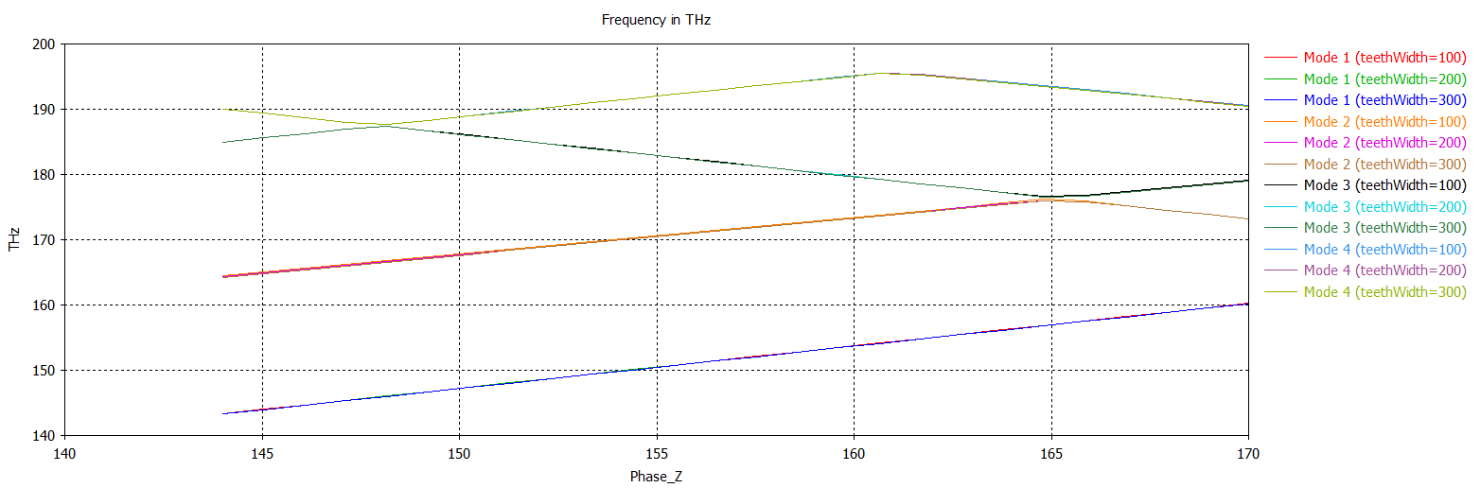
teethWidth variation
Varying teethWidth does not change it at all

Slide 20
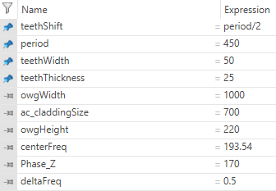
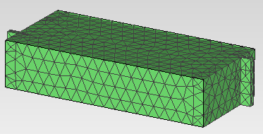
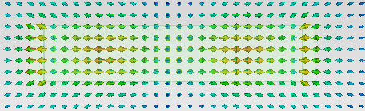

Period variation (includes teethShift)
Mode 3

Slide 21




Period variation2
Too small teeth, can’t scale everything to get the SIP at 193 THz
Found an SIP!!!!

Slide 22
Period variation
Yes, but the dispersion diagram curves do not change too much when you change the teethThickness

Slide 23


More period variation

Slide 24




I found an SIP! At the wrong frequency
I tried scaling all the geometrical parameters by $f$
It does not work

Slide 25

Current attempts
I am also adjusting the owgWidth with $f$
I wrote an optimizer that varies all the parameters (including owgWidth), to find an SIP at a frequency larger than $190$THz
I am also going to be varying owgWidth to see how much the dispersion diagram changes (and the mode 3 energy density)

Slide 26




Adjusting owgWidth with $f$
Not a confined mode

Slide 27



Manually adjusting owgWidth
Mode 3 with owgWidth = 700

Slide 28


Let’s refine the previous result
Mode 3 with owgWidth = 650
Mode 3 with owgWidth = 600

Slide 29

owgWidth variation

Slide 30



Slide 31


What is the connection between period & owgWidth?
Period = 310, owgWidth = 600 -> Close to SIP at approx. 215 THz
If there was a linear relationship between them, the curves would not change shape, only frequency

Slide 32
Setting up sweeps of:
owgWidth small sweep to get the SIP (CourseCorrection)
teethWidth small sweep to get the SIP (CourseCorrection – Copy)

Slide 33



Period fine tuning

Slide 34




teethWidth fine tuning

Slide 35




SIP. Period.

Slide 36


SIP. teethWidth.

Slide 37
Corrugated waveguide – Optimization
A. Herrero Parareda and F. Capolino
Department of Electrical Engineering and Computer Science

Slide 38
RBE and SIP optimization goals

